Slide 1
What is .NET

Slide 2
outline
.NET framework
CLR
CLI, CIL, MSIL
ADO.NET, ASP.NET, MVC, webforms, razor
Mono
.NET Core
.NET Standard

Slide 3
.NET framework
Software framework
First released early 2000’s
“consists of the common language runtime (CLR) and the .NET Framework class library (FCL)” [1]
Provides a “code execution environment”
Various runtime hosts for the CLR [2]
ASP.NET (via ISAPI filter)
Executable
Can write your own
Notes:
[1] https://docs.microsoft.com/en-us/dotnet/framework/get-started/overview
[2] https://msdn.microsoft.com/en-us/library/a51xd4ze(v=vs.71).aspx

Slide 4
CLR
The virtual machine that manages execution of .NET programs [3]
Memory
Threads
Code trust
Type checking
pinvoke
JIT compiling to execute on current hardware
Notes:
[3] https://en.wikipedia.org/wiki/Common_Language_Runtime

Slide 5
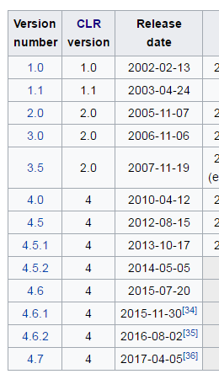
.NET Framework and CLR
Framework and CLR are different [4]
Can technically run different framework versions within the same CLR version
E.g. Windows XP only supports framework up to 4.0, running 4.5 apps is theoretically possible (with some hex editing of the binary) as long as calls are restricted to methods that were the same in 4.0 (e.g., no extensions) [5]
Recent framework updates have been focused on
Optimization (including SIMD)
Accessories (stylus, touch screen, etc)
Security
Notes:
[4] https://en.wikipedia.org/wiki/.NET_Framework
[5] https://stackoverflow.com/questions/17499351/is-it-possible-to-run-a-net-4-5-app-on-xp

Slide 6
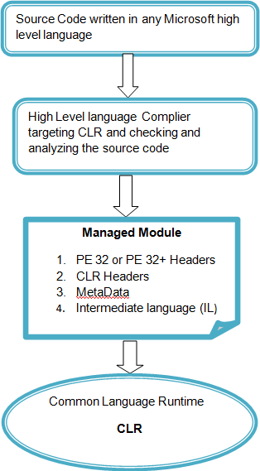
CLR, CLI, CIL
Common Language Infrastructure (CLI)
Open standard that describes executable code [6]
Common Intermediate Language (CIL) [7]
Aka “IL”
Formerly MSIL
Object oriented assembly language
Platform independent
A compiler takes source code and
Converts it to CIL using the CLI specification
Adds any required metadata (type information, etc)
This is an “assembly”
Notes:
[6] https://en.wikipedia.org/wiki/Common_Language_Infrastructure
[7] https://en.wikipedia.org/wiki/Common_Intermediate_Language

Slide 7
CLR, CLI, CIL
Visual Studio tooling supports compiling C#, F#, VB.NET to CIL
Semi C++ support [8]
Language support include IronPython, ClojureCLR, IronScheme, others [10]
Can write your own compiler
C to CIL example in F# [9]
Ahead of time (AOT) compilation to avoid JIT
Has some performance benefits
No longer portable across hardware
CIL makes calling a method in another CIL library convenient
Managed by CLR, vs unsafe dll call through pinvoke
Notes:
[8] https://stackoverflow.com/questions/688386/is-c-converted-into-msil
[9] http://timjones.io/blog/archive/2014/04/13/writing-a-minic-to-msil-compiler-in-fsharp-part-0-introduction
[10] https://en.wikipedia.org/wiki/List_of_CLI_languages

Slide 8
CLR, CLI, CIL
The CIL is available at runtime
Metadata for the assembly needs to be available to the CLR
This is generally available at runtime as well
Can use this information to modify code at runtime
See [21] which references [22]
Useful for performance profiling, anti-debug avoidance
Other more suitable tools exist for aspect oriented programming (AOP) and mocking frameworks
Notes:
[21] https://stackoverflow.com/a/19403979/1462295
[22] https://www.codeproject.com/Articles/463508/NET-CLR-Injection-Modify-IL-Code-during-Run-time
Also, CIL assembly is rather straightforward to decompile back into code (at least for C#) so legacy binary fix doesn’t seem like the ideal use case

Slide 9
.NET framework
Includes a set of standard class libraries [11]
Base Class Library (BCL) [12]
Intrinsic types (e.g. string, datetime) and other base classes (e.g. FileStream)
Follows ECMA specification
Framework Class Library (FCL)
Broader library base
Depends on BCL
Provides extensions, like LINQ methods
System.Web, System.Data, System.Collections, System.Xml etc [13]
Source available at [16]
Also includes libraries for winforms, WPF, WCF, ASP.NET, etc
These other libraries are mostly still proprietary (and will probably remain so)
Notes:
[11] https://stackoverflow.com/questions/807880/bcl-base-class-library-vs-fcl-framework-class-library
[12] https://en.wikipedia.org/wiki/List_of_data_types_of_the_Standard_Libraries#Base_Class_Library
[13] https://msdn.microsoft.com/en-us/library/gg145045(v=vs.110).aspx
[16] http://referencesource.microsoft.com/

Slide 10
ADO.NET, ASP.NET, MVC, webforms, razor
ADO.NET is a .NET Framework library to interact with (MSSQL) database
Entity Framework is ORM for ADO.NET
ASP.NET is a .NET framework library to serve dynamic web pages [14]
Typically hosted in IIS
Pages are “Web Forms”
Has “code behind” file and view file
Pages need to be compiled like source code
Notes:
[14] https://en.wikipedia.org/wiki/ASP.NET

Slide 11
ADO.NET, ASP.NET, MVC, webforms, razor
ASP.NET cont
MVC is an extension to ASP.NET that comes with Visual Studio
Implements Model-View-Controller design pattern
Methods for a page are handled in the controller, or somewhere else as defined in route setup
Can still include code in the view itself, same as before
Razor is typically used with MVC
Entire state of the webpage (“ViewState”) no longer needs to be passed around with every server call
Page is no longer re-rendered with every server call
Views are compiled on demand and can be changed at runtime
No more
if (!IsPostback)
// generate form
else
// process submitted data;

Slide 12
ASP.NET visualized
.NET Framework
ASP.NET
(WebForms)
ASP.NET extensions
Razor
FCL
MVC
CLR
BCL
Extensions available through Visual Studio, elsewhere

Slide 13
Mono
Started as open source C# compiler and CLR [15]
“Mono” includes the mono libraries (e.g. POSIX and OS libraries), Code Execution Engine, etc
Alternative to .NET Framework
MonoDevelop is the IDE
Notes:
[15] https://en.wikipedia.org/wiki/Mono_(software)

Slide 14
.NET core
Cross platform, open source [17]
Alternative to .NET framework
CoreCLR
Fork of FCL
ASP.NET core
Universal Windows Platform (UWP) libraries
Adds additional libraries
Missing some .NET Framework libraries
Windows forms, WPF
Adds deployment to have self contained applications (via AOT compilation) [20]
Notes:
[17] https://docs.microsoft.com/en-us/dotnet/core/
[20] https://github.com/dotnet/coreclr/blob/master/Documentation/building/crossgen.md

Slide 15
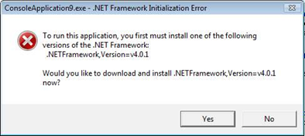
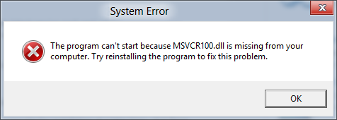
Compare to .NET Framework, or C++

Slide 16
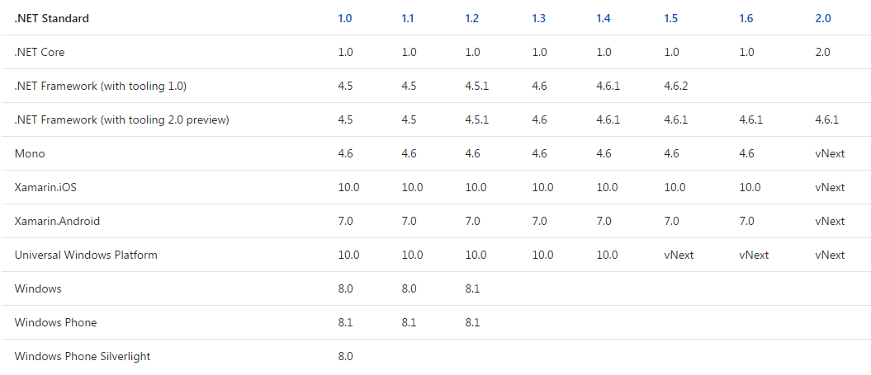
.NET Standard
Set of API specifications (guidelines, not code)
Supposed to be supported by multiple frameworks [18]
Version commentary about 1.6 -> 2.0 at [19]
Notes:
[18] https://docs.microsoft.com/en-us/dotnet/standard/library
[19] https://github.com/dotnet/standard/tree/master/docs/netstandard-20

Slide 17
.NET Standard
Unifying library across platforms
Mostly based on .NET Framework mscorlib (BCL, FCL, “and friends” [19])
Binary compatible, not necessarily behavioral compatible

Slide 18
.NET FRAMEWORK
.NET CORE
MONO
XAMARIN
Classes
WPF
UWP
GTK#
iOS
Windows Forms
ASP.NET Core
POSIX
OS X
ASP.NET
Android
.NET Standard
BCL
FCL (partial?)
System.Runtime
Runtime
CLR
CoreCLR
Mono CLR
*
Each framework has more libraries not shown (OS specific, compatibility, etc)
Sticking to BCL and FCL is mostly cross platform, works well for simple console apps
Notes:
iOS doesn’t allow virtual code to be run like other platforms, so there’s no JIT and everything is AOT compiled. Not sure about android or OS X.

Slide 19
References
[1] https://docs.microsoft.com/en-us/dotnet/framework/get-started/overview
[2] https://msdn.microsoft.com/en-us/library/a51xd4ze(v=vs.71).aspx
[3] https://en.wikipedia.org/wiki/Common_Language_Runtime
[4] https://en.wikipedia.org/wiki/.NET_Framework
[5] https://stackoverflow.com/questions/17499351/is-it-possible-to-run-a-net-4-5-app-on-xp
[6] https://en.wikipedia.org/wiki/Common_Language_Infrastructure
[7] https://en.wikipedia.org/wiki/Common_Intermediate_Language
[8] https://stackoverflow.com/questions/688386/is-c-converted-into-msil
[9] http://timjones.io/blog/archive/2014/04/13/writing-a-minic-to-msil-compiler-in-fsharp-part-0-introduction
[10] https://en.wikipedia.org/wiki/List_of_CLI_languages
[11] https://stackoverflow.com/questions/807880/bcl-base-class-library-vs-fcl-framework-class-library
[12] https://en.wikipedia.org/wiki/List_of_data_types_of_the_Standard_Libraries#Base_Class_Library
[13] https://msdn.microsoft.com/en-us/library/gg145045(v=vs.110).aspx
[14] https://en.wikipedia.org/wiki/ASP.NET
[15] https://en.wikipedia.org/wiki/Mono_(software)
[16] http://referencesource.microsoft.com/
[17] https://docs.microsoft.com/en-us/dotnet/core/
[18] https://docs.microsoft.com/en-us/dotnet/standard/library
[19] https://github.com/dotnet/standard/tree/master/docs/netstandard-20
[20] https://github.com/dotnet/coreclr/blob/master/Documentation/building/crossgen.md
[21] https://stackoverflow.com/a/19403979/1462295
[22] https://www.codeproject.com/Articles/463508/NET-CLR-Injection-Modify-IL-Code-during-Run-time

